Slide 1
It’s not a technology problem:
Practical tips for effectively leading digital transformations

Slide 2
Today you’ll walk away with:
A SOO Template and example
A tool used to ensure quality work
Questions to ask your organization
Notes:
[if this feels like too many slides, you can skip this one]

Slide 3
18F is a civic consultancy for the U.S. government, inside the U.S. government.
Notes:
[if this feels like too many slides, you can skip this one]

Slide 4
18F is a civic consultancy for the U.S. government, inside the U.S. government.
We’re federal employees.

Slide 5
Let’s talk about procuring custom IT.

Slide 6






Using these skills:
Product management to ensure you’re building the right thing and making the right choices
Iterative development to deliver value to users faster, learn from each release, and continuously improve
Human-centered design to focus on software that meets actual people’s needs
Openness in communication, code, and process so that others can learn from or reuse work
DevSecOps practices, which improve software quality, deploy quickly, and maintain security
Structure procurements to support agile delivery, increase quality, and avoid vendor lock-in

Slide 7
Product management is about defining the outcomes that we’re trying to achieve… and then keeping development pointed at those outcomes.
Product management

Slide 8
Government staff need to own strategic choices and tradeoffs.
Product management

Slide 9
All of our work should be driven by the wants and needs of real, live end users.
Human-centered design

Slide 10
Show what you’re making to the people who will use it. Do this early and often.
Human-centered design

Slide 11
Integrating development, security, and operations (with a healthy dose of automation) reduces risk and makes development faster.
DevSecOps

Slide 12
Offboard repetitive tasks to computers, and focus on human collaboration.
DevSecOps

Slide 13
Plan your projects in small pieces, focusing on things that are close enough for you to see accurately.
Iterative development

Slide 14
Once you have the foundation in place, you can now break up big, risky contracts into manageable pieces.
Structure procurements

Slide 15
Contracts can get awarded faster.
Structure procurements

Slide 16
A hands-on, collaborative approach to post award management increases your chances of success.
Openness

Slide 17
In practice...

Slide 18
Please stop trying to outsource all the risk.
There’s not a single COTS solution to run your Medicaid system.
Dear government,

Slide 19
A COTS product is usually a computer hardware or software product tailored for specific uses and made available to the general public.
FAR: A commercial item sold in substantial quantities in the commercial marketplace, without modification.
Dear vendors,
Notes:
A typical example of a COTS product is Microsoft Office or antivirus software. A COTS product is generally any product available off-the-shelf and not requiring custom development before installation.
A commercial item sold in substantial quantities in the commercial marketplace; and offered to the Government, under a contract or subcontract at any tier, without modification, in the same form in which it is sold in the commercial marketplace

Slide 20
Don’t outsource all of the strategic decisions and tradeoffs.
Instead, embed program staff with the development team to lead.
Dear government,

Slide 21
Work together with program staff to help them make strategic decisions.
Dear vendors,
Notes:
Provide your technical expertise to the government staff to help them prioritize and make decisions as the project goes.

Slide 22
Don’t wait until the very end to show your users and stakeholders.
Instead, ask real users to give you feedback as you go (even when things are messy/ugly/bad).
Dear government,

Slide 23
In order to support user testing,
be prepared to release product updates regularly so you can get feedback from real users.
Vendors
Dear vendors,
Notes:
Maybe that means deploying to staging or testing so users can try it out. It doesn’t necessarily mean going to production every day, but it definitely means users can see the latest stuff regularly.

Slide 24
Don’t separate development, operations, and security.
Instead, bring them all together (and automate).
Government
Dear government,

Slide 25
Plan to set up a regular deployment pipeline and automated tests.
Integrate with the program team to set up the infrastructure.
Vendors
Dear vendors,
Notes:
This is how modern software is done. Everywhere. Push government partners to adopt this - it makes your job easier and their outcomes better.

Slide 26
Don’t try to write all of the detailed requirements for the project up front.
Instead, ruthlessly prioritize your desired outcomes and make incremental progress toward them.
Government
Dear government,
Notes:
Prioritize!

Slide 27
Don’t expect or create a complete list of requirements at the start of the project.
Instead, expect change and plan for short periods (2–4 weeks) based on a set of long-term objectives.
Vendors
Dear vendors,

Slide 28
Don’t let your vendor work for months or years without showing progress.
Instead, ask to review code and see demos of work in progress every 2–4 weeks.
Government
Dear government,

Slide 29
Don’t expect to work for months or years without showing progress.
Instead, plan for code reviews and demos of work in progress every 2–4 weeks.
Vendors
Dear vendors,

Slide 30
Don’t sign long, large ($10M+) contracts.
Instead, break big projects into shorter, smaller ($2–3M) contracts with options to extend.
Government
Dear government,

Slide 31
Don’t expect to be the sole vendor on long, large ($10M+) contracts.
Instead, plan to be one of several vendors on a project. Show your work to prove your value.
Vendors
Dear vendors,

Slide 32
Delivering value quickly is a competitive advantage.
Vendors
Dear vendors,

Slide 33
Write your own!

Slide 34
But I thought you said this wasn’t a technology problem?

Slide 35
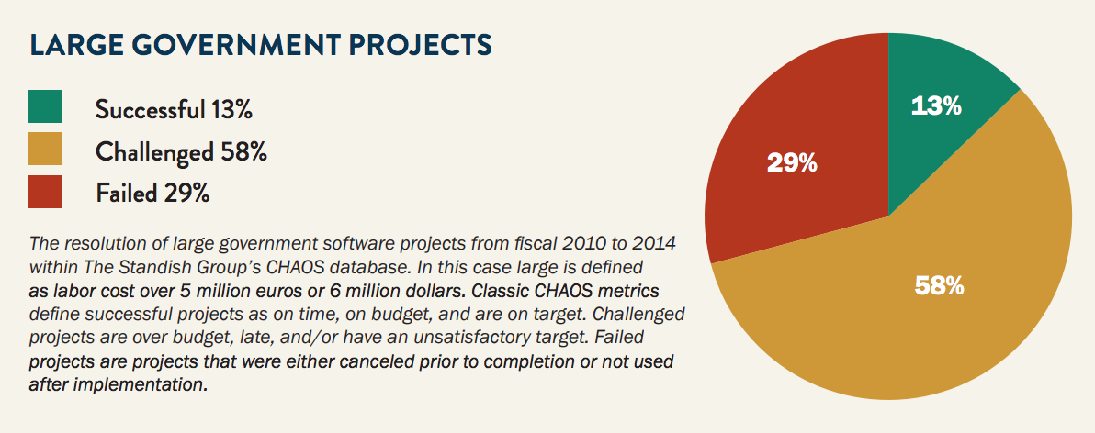
Notes:
The great majority of government software projects either fail outright or fail to achieve their goals. Only 13% are successful.

Slide 36
Procurement
Procurement
Procurement

Slide 37
Practical Tips for leading IT modernization projects
There are alternatives to getting locked into single vendor proprietary systems.

Slide 38
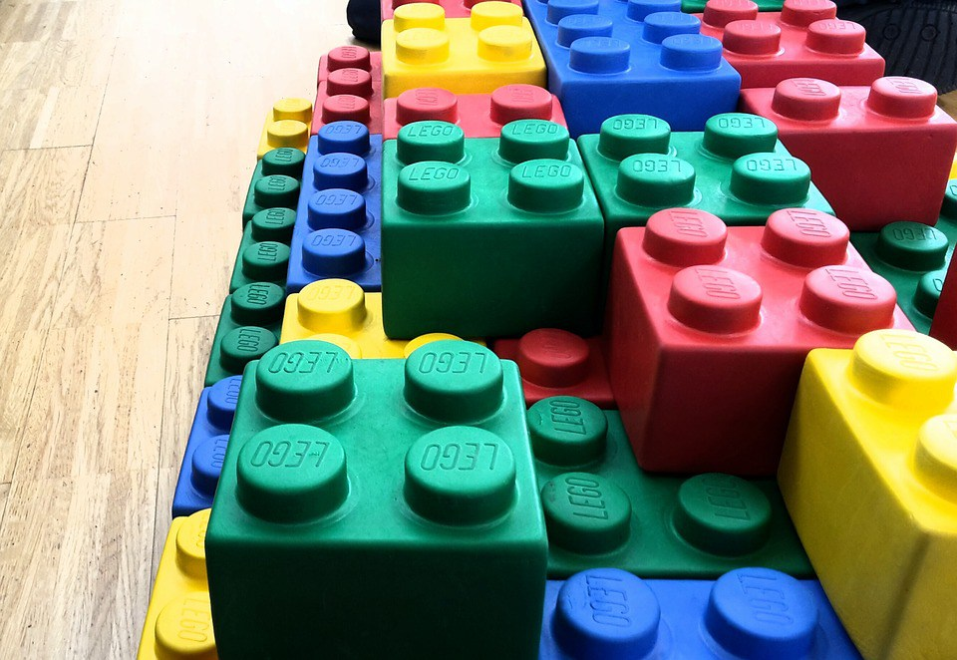

Slide 39
Practical Tips for leading IT modernization projects
There are alternatives to getting locked into proprietary systems.
Buying Software is not like buying a bridge...It’s never “done”

Slide 40
Practical Tips for leading IT modernization projects
There are alternatives to getting locked into proprietary systems.
Buying Software is not like buying a bridge...It’s never “done”
Reducing risk comes from smaller contracts and quick delivery periods

Slide 41
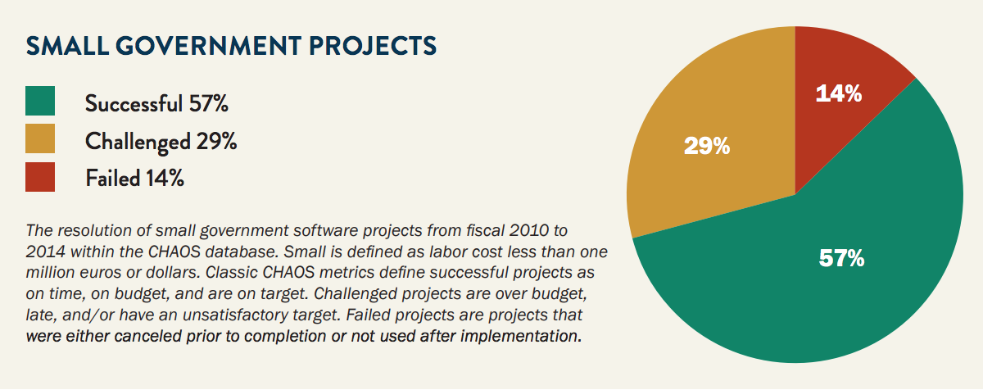
Notes:
Small government software projects are much more likely to succeed. This survey of small government software projects (less than $6M) find that the majority are successful.

Slide 42
Practical Tips for leading IT modernization projects
There are alternatives to getting locked into proprietary systems.
Buying Software is not like buying a bridge...It’s never “done”
Reducing risk comes from smaller contracts and quick delivery periods
Don’t try to do everything at once

Slide 43
Practical Tips for leading IT modernization projects
There are alternatives to getting locked into proprietary systems.
Buying Software is not like buying a bridge...It’s never “done”
Reducing risk comes from smaller contracts and quick delivery periods
Don’t try to do everything at once
Share and learn from your colleagues from other states

Slide 44
Practical Tips for leading IT modernization projects
There are alternatives to getting locked into proprietary systems.
Buying Software is not like buying a bridge...It’s never “done”
Reducing risk comes from smaller contracts and quick delivery periods
Don’t try to do everything at once.
Share and learn from your colleagues from other states
Lighten up your Procurements to Attract More Vendors

Slide 45
Practical Tips for leading IT modernization projects
There are alternatives to getting locked into proprietary systems.
Buying Software is not like buying a bridge...It’s never “done”
Reducing risk comes from smaller contracts and quick delivery periods
Don’t try to do everything at once.
Share and learn from your colleagues from other states
Lighten up your Procurements to Attract More Vendors
Hire in-house Tech Talent

Slide 46
Practical Tips for leading IT modernization projects
There are alternatives to getting locked into proprietary systems.
Buying Software is not like buying a bridge...It’s never “done”
Reducing risk comes from smaller contracts and quick delivery periods
Don’t try to do everything at once.
Share and learn from your colleagues from other states.
Lighten up your Procurements to Attract More Vendors
Hire in-house tech talent
Leadership needs to be fully engaged

Slide 47
This all sounds great…
But does it really work?

Slide 48
U.S. Tax Courts
An overview of what’s possible
‹#›

Slide 49
Background

Slide 50
The United States Tax Court is a federal trial court that specializes in disputes over federal income tax.
It’s made up of 19 judges appointed by the President and confirmed by the Senate.
‹#›

Slide 51
When we met them, they were dealing with a legacy system that was expensive, didn’t meet user needs, and didn’t let them access their own data.
‹#›

Slide 52
They were stuck with this system thanks to a license agreement signed in 1983.
‹#›

Slide 53
The approach

Slide 54
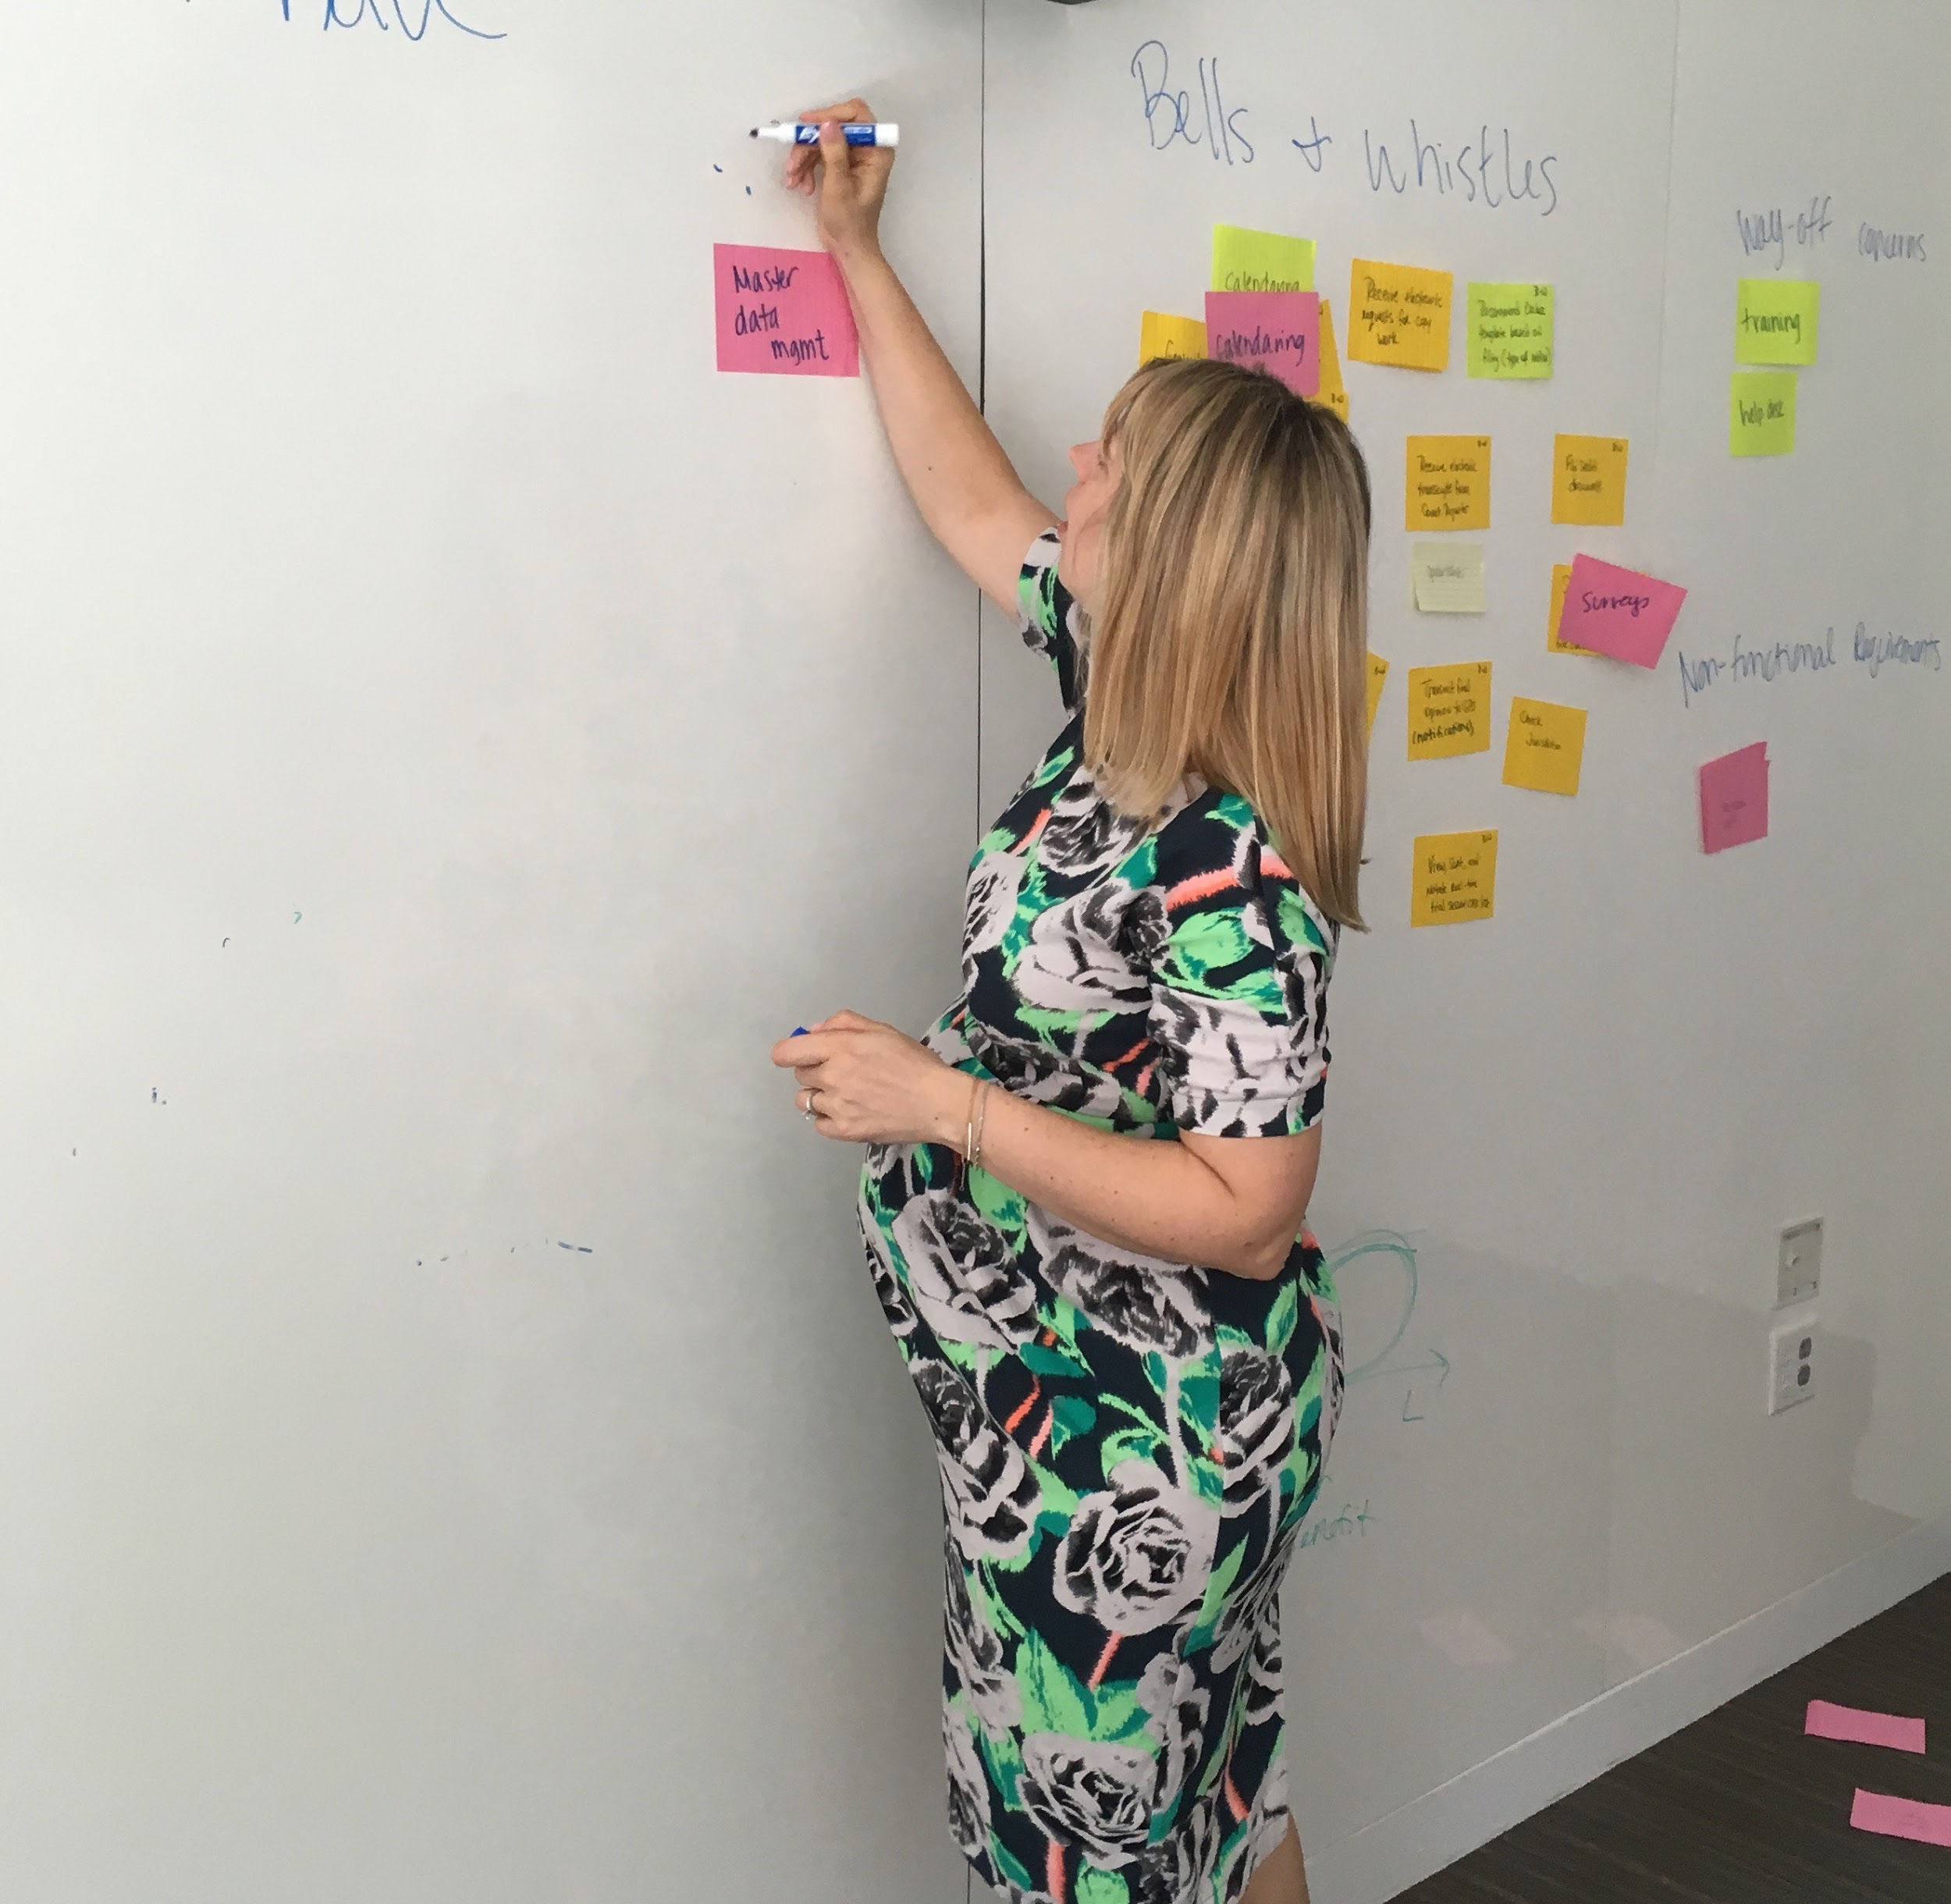
Cross-functional
Workshop
Discuss current pain points
Paint the picture of a future of building an open source product they can maintain indefinitely
Develop product vision and backlog
Gain commitment of an empowered product owner
‹#›

Slide 55
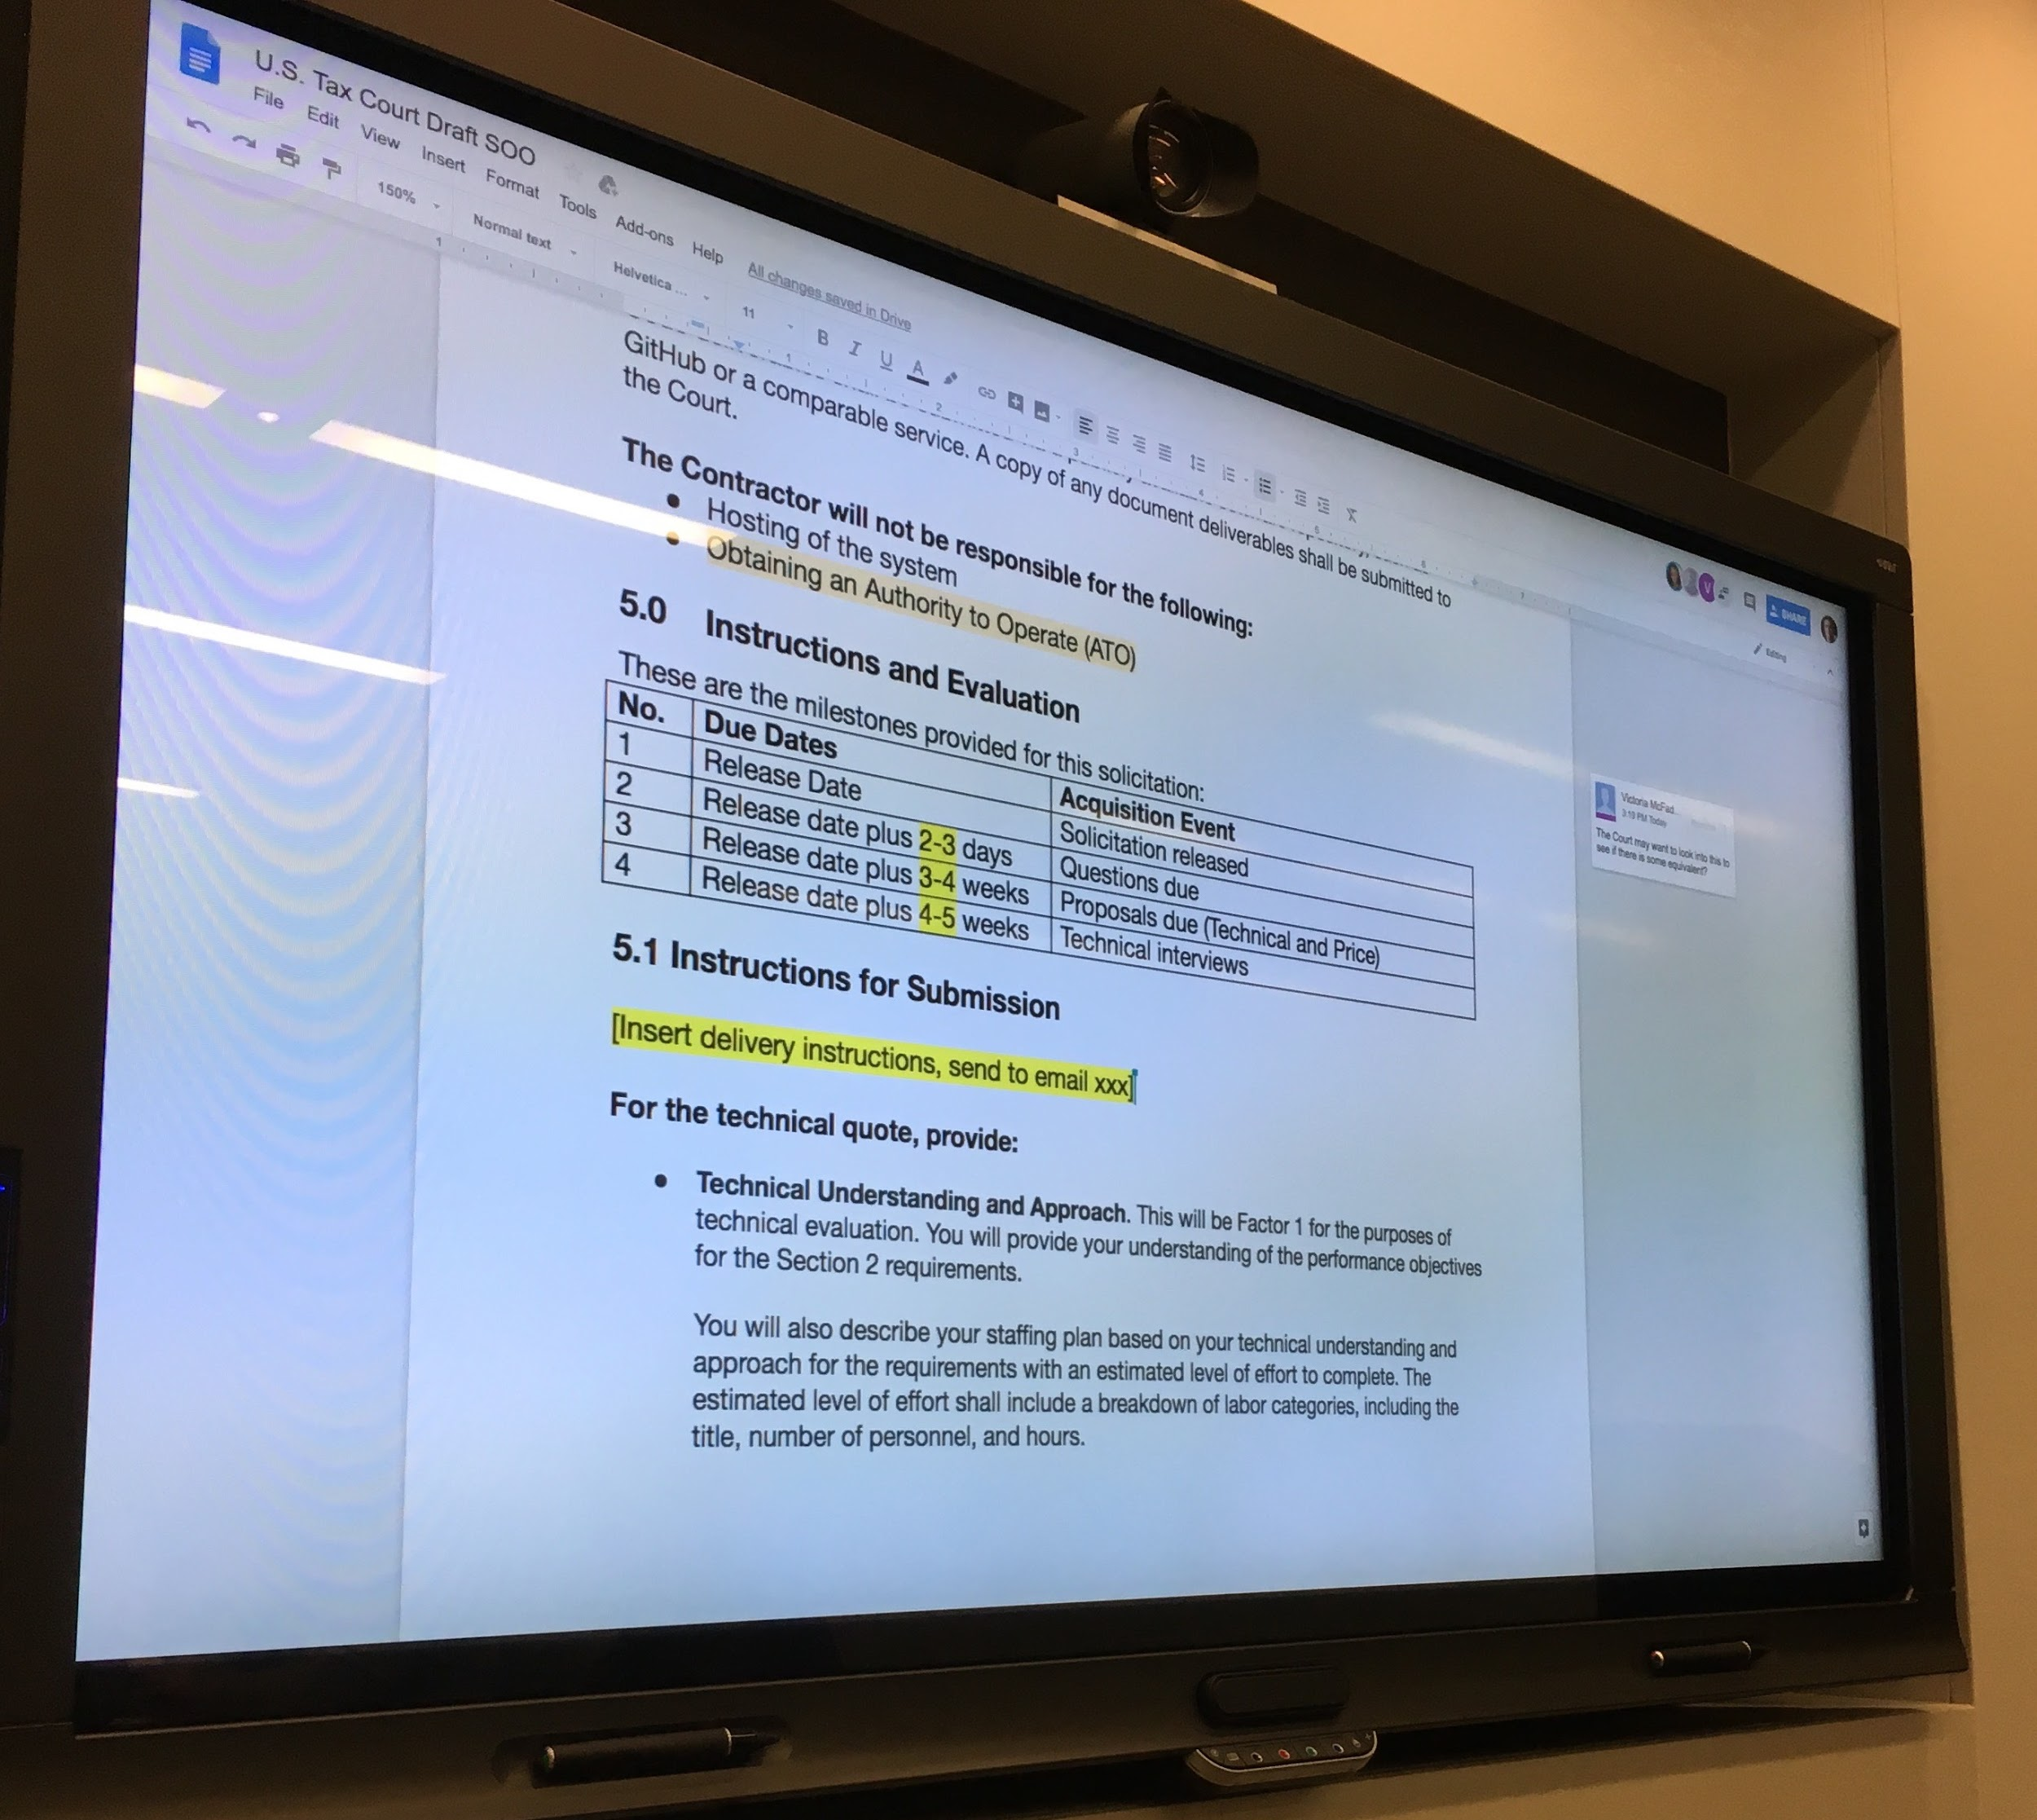
Acquisition
Co-write the acquisition package
Post RFQ on GitHub to get transparent feedback and targeted industry engagement
Advise the evaluation panel
Conduct code reviews
Assist with contractor interviews
‹#›
Notes:
RFP was less than 30 pages. Posted on easily accessible website. Asked for less than 10 pages of proposals.

Slide 56
Timeline
DAY 1–3
43
67
80
102
136
172
Host workshop & draft RFQ
Post draft RFQ for Q&A
Post answers
Post final RFQ
Receive bids
Award contract
Accept first code from contractor
‹#›

Slide 57
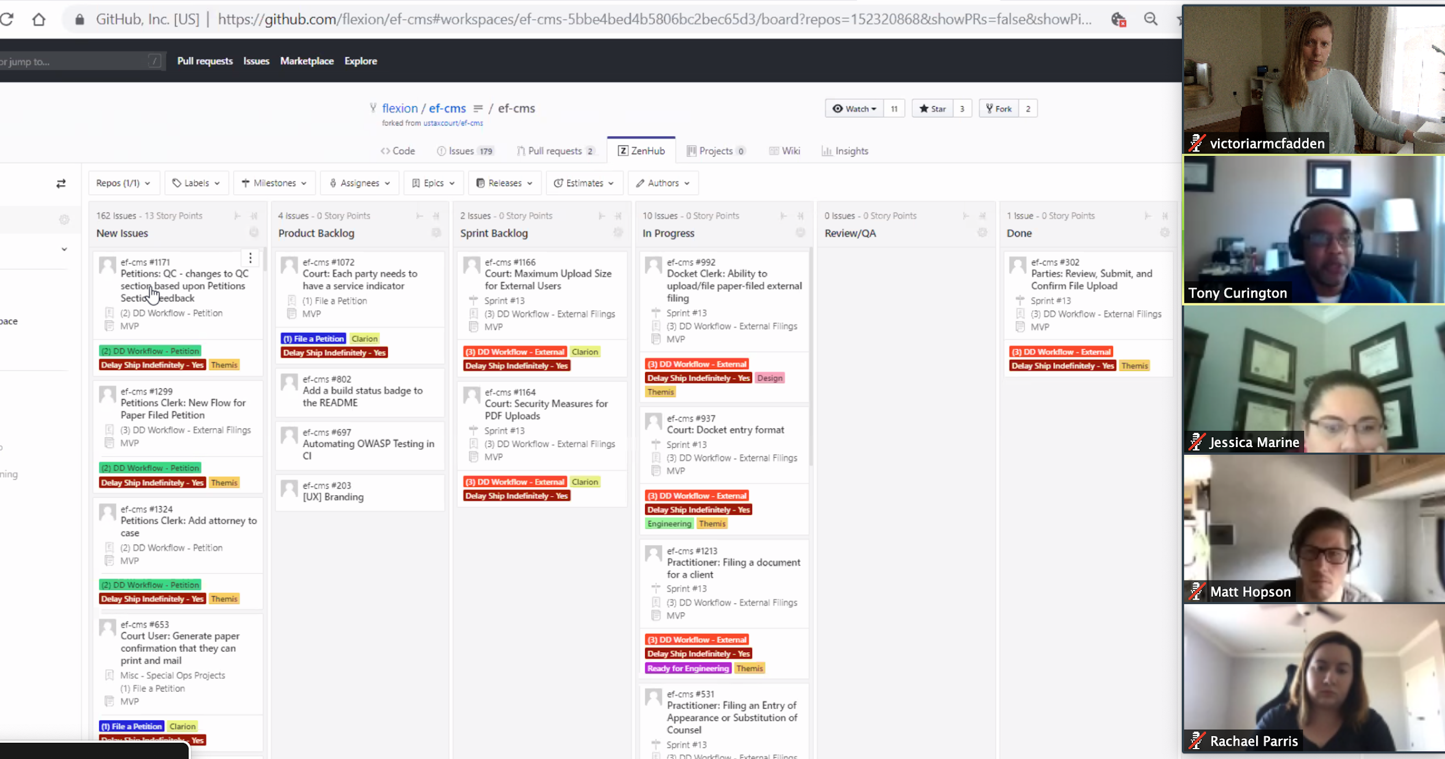
Results
8 bids
4 vendor interviews - all had quality approaches to software development.
Vendor is collaborating with the Court to build a modern case management system.
Developing a continuous ATO process
Value is delivered EVERY 2 WEEKS.
‹#›

Slide 58
What they are saying....

Slide 59
“When we show this to the practitioners it’s going to blow their mind.”
– Tax Court’s Product owner
‹#›
Notes:
from my perspective, all aspects of this project couldn't be going better. It's like text book.

Slide 60
“The work I’m doing on this project is the most valuable and satisfying work of my career.”
– Contractor’s tech lead
‹#›

Slide 61
“That’s dope. It’s going to make my job so much easier.”
– Tax Court End User
‹#›

Slide 62
Bottom Line
This can be done!
Government can gain back control of their mission!
Tech Industry software designers and developers like working this way
Stop spending 2 years gathering requirements in HQ. Focus on outcomes for users!
‹#›

Slide 63
Up next...

Slide 64
Today you’ll walk away with:
A SOO Template and example
A tool used to ensure quality work
Questions to ask your organization
Notes:
[if this feels like too many slides, you can skip this one]

Slide 65
Thanks!
Amy.Ashida@gsa.gov
Robin.Carnahan@gsa.gov
Randy.Hart@gsa.gov
Greg.Walker@gsa.gov
Contact 18F@gsa.gov
Follow @18F
Work Together github.com/18F

